Slide 1
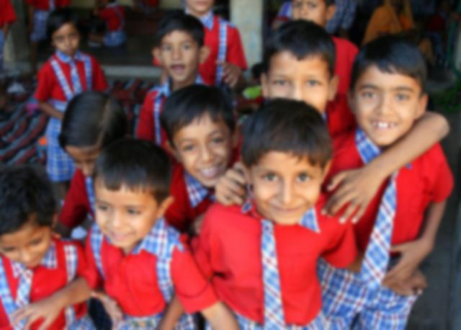
low cost learning installation for Indian schools
Degree Project - II l Guide: Prof. Anirudha Joshi l Ishneet Grover l Interaction Design [09-11]

Slide 2
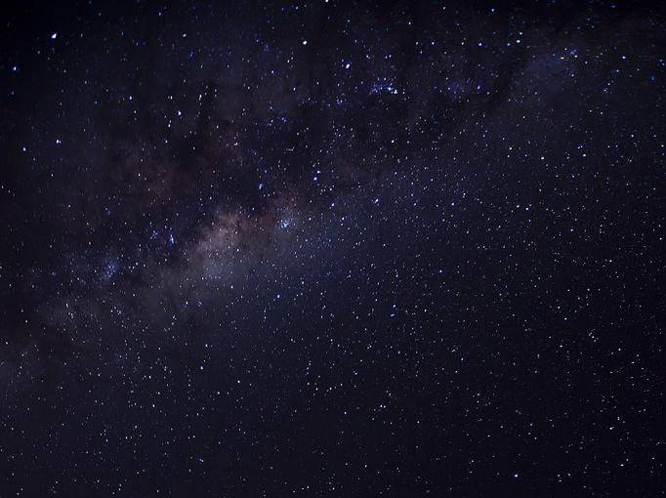

journey (last 5 months)
Dawn of new experience in my life - (saw ray of what my project could be)

Slide 3
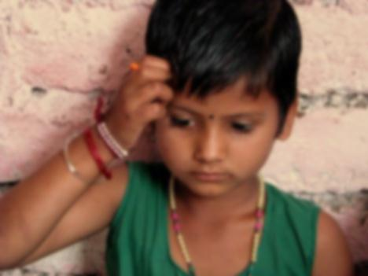
initial thoughts
I
always wanted to design and build
real tangible interaction, a project which uses my full engineering capabilities
with design as focus
was in doing internship at London &.. AJ Sir told, “Give Project Topics … Grrrrr”
started
was in London, visiting science museums …
felt why I didn’t get to see all these when I was small …
that’s because
I could never go to science museum & see all this
??

Slide 4
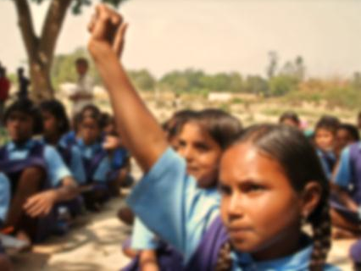
initial thoughts
Ideachamaka
“Why not do something for Indian children like me,
so that they can experience science museums when they should”
so I took up this as my Degree Project - II

Slide 5
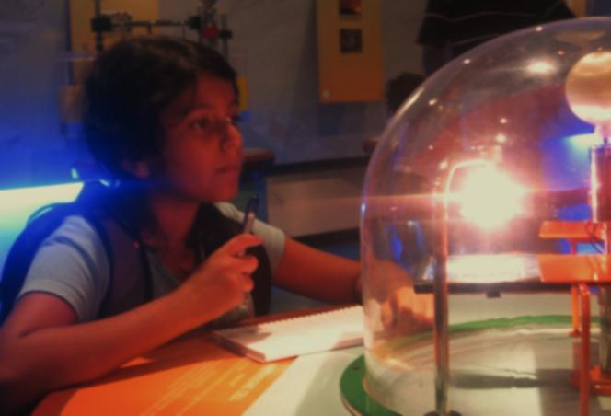
initial thoughts
today there are 12,50,775 primary schools in India
& only 27 science centers
students from major city can afford to go to Science museums but they are taken just for couple of hours and that to once or twice in whole span of schooling
(12 years of schooling and just 1 day of visit to science center)
chances of children from smaller towns visiting science centers is very rare
the problem is children cannot be take to Science center all the time
“why not science center come to school”
“How to make this possible?”
I have attempted this in my Project?

Slide 6
journey (last 5 months)
Dawn of new experience in my life - (saw ray of what my project could be)
Notes:
Now I can see what can do for next 4 months

Slide 7
journey (last 5 months)
Early morning started running - (meeting children, teachers, researchers)
Dawn of new experience in my life - (saw ray of what my project could be)
Notes:
I started with the user studies at various schools and science centres

Slide 8






user research
ye bole…
“sab ke saath maze aate hai”
“akele kya karnege idhar, madamlog padhate hai zayada”
“screen pe se padne se samjh aaya”
“yahan to kabhi kabhi thode time ke liye aate hai”
aur bole…
“hamare school me bhi ye ho tho maja aayega”
“school bhi aisahi hona chahiye”
“yahan khel sakte hai”
Notes:
Users and their quotes… from researchers, teachers and students …You should Tell what your inferences are from these statements … thts really important

Slide 9

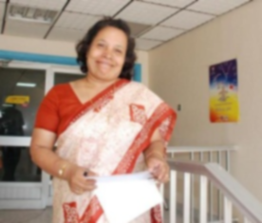
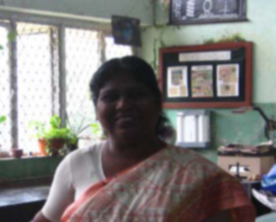

user research
“teachers with B.Sc background have a lot of problem in giving practical sessions”
“bringing children here is helpful but there are time constraints”
“children respond better after their visit to science center”
“they try to make connections”
“it gives them first hand experience”
“Children usually do not ask questions about proportion when we show them a model or a machines”
“we are using e-beam technology to involve child for interactive learning”
Notes:
Users and their quotes… from researchers, teachers and students …You should Tell what your inferences are from these statements … thts really important

Slide 10
user research
“it becomes difficult to explain on a 2d surface”
“the most difficult thing is to explain 3D concepts”
“it is not done every week as the time for the curriculum s very less and the syllabus need to be completed on time”
“Everyday we can’t do activities”
“Only Children who are ahead in class run after the class to ask questions, so I satisfy there curiosity”
“We show them animated pictures for better understanding”
Notes:
Users and their quotes… from researchers, teachers and students …You should Tell what your inferences are from these statements … thts really important

Slide 11
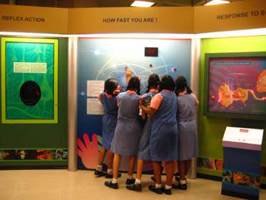
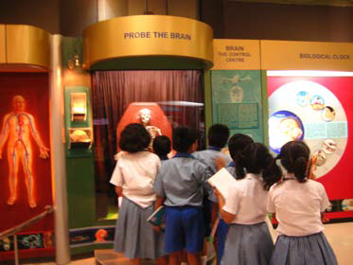
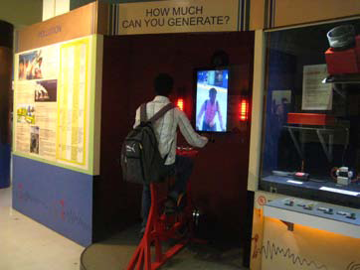
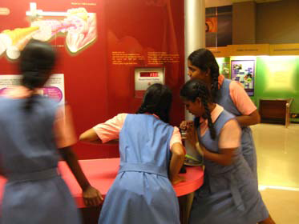
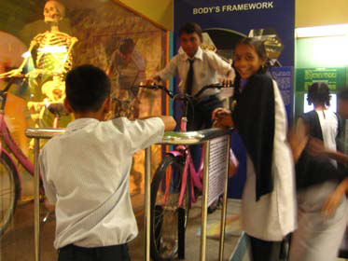
visit to Science Centers
Yaha gayii …
Nehru Science center - Mumbai
Science Center - Banglore
The atmosphere completely changes , if both school and science centers are place of education; children enjoy and play in science centers like anything as compared to school. Still learning is happening and its comparatively hands on.
Notes:
Observations in Science center and different installations …

Slide 12
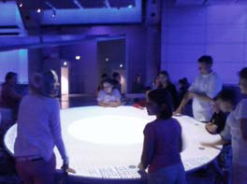
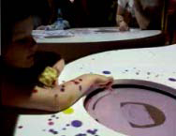
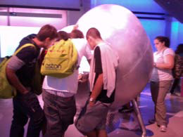
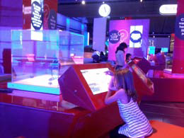
visit to Science Centers
Vaha bhi bhagii …
Science centers - London
Interactive Installations at London are far more advanced and better both in number and quality, like use of latest technology and even design wise they make more sense what they want to educate. Indian science centers are lagging behind and we need to catch up.
Notes:
Observations in Science center and different installations …

Slide 13
journey (last 5 months)
Early morning started running - (meeting children, teachers, researchers)
Dawn of new experience in my life - (saw ray of what my project could be)

Slide 14
journey (last 5 months)
Played with toys and started understanding - (hands on experience and analysis)
Early morning started running - (meeting children, teachers, researchers)
Dawn of new experience in my life - (saw ray of what my project could be)

Slide 15
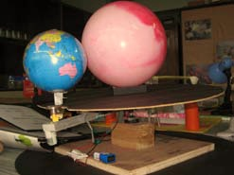
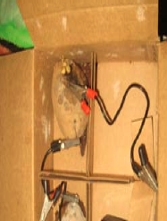
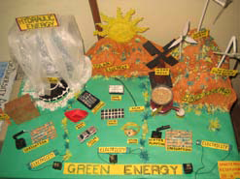
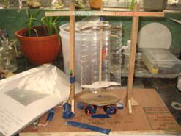
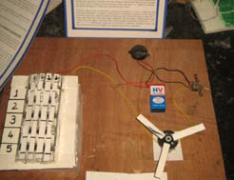
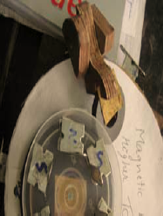
played with interesting toys
Some Projects done by primary school students
Password using motors and switches
Generate electricity through potato, etc.
Notes:
Scientific toys with which you played and some points related to it …

Slide 16
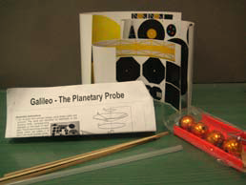
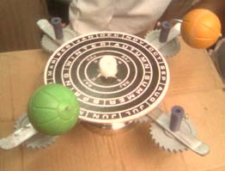
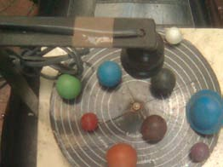
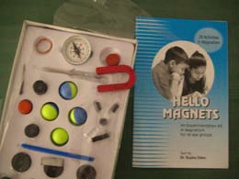
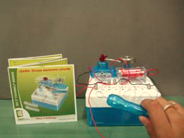
played with interesting toys
Some existing educational toys
To teach,
Electromagnetism, Electricity
And comparatively many used to explain concepts of solar system
Notes:
Scientific toys with which you played and some points related to it …

Slide 17
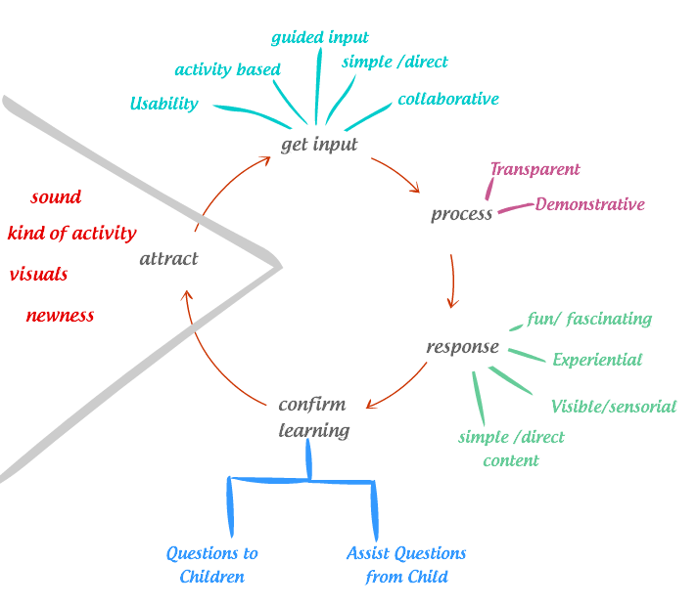
fir maine socha … aisa kyu???
kya hona chahiye ??? … aisa kuch hona chahiye jo …
principles which I thought should be kept in mind while designing…
for a good learning installation for children ,
it must have following capabilities:
1. Ability to attract users.
2. Get relevant input from the users.
3. Process input in a transparent fashion for evident learning.
4. Give effective response to children so that they learn.
5. Confirm learning.
principles have been derived for each step of interaction as shown in the chart.
one of important steps is to assist questions form the
child and secondly prompt them to ask questions.
Notes:
Some analysis and conclusions … and derivations …

Slide 18
fir maine socha … aisa kyu???
but some … Challenges and Concerns:
how to simplify the content so that children can understand it?
at the next step:
how to design such that the same installation can be made a reconfigurable installation?
how to complete the project within provided time frame
looking at the scope of the project ☹
Notes:
Some analysis and conclusions … and derivations …

Slide 19
journey (last 5 months)
Played with toys and started understanding - (hands on experience and analysis)
Early morning started running - (meeting children, teachers, researchers)
Dawn of new experience in my life - (saw ray of what my project could be)

Slide 20
journey (last 5 months)
What content best suits to be taught - (detailed content to teach & how its tried today)
Played with toys and started understanding - (hands on experience and analysis)
Early morning started running - (meeting children, teachers, researchers)
Dawn of new experience in my life - (saw ray of what my project could be)

Slide 21
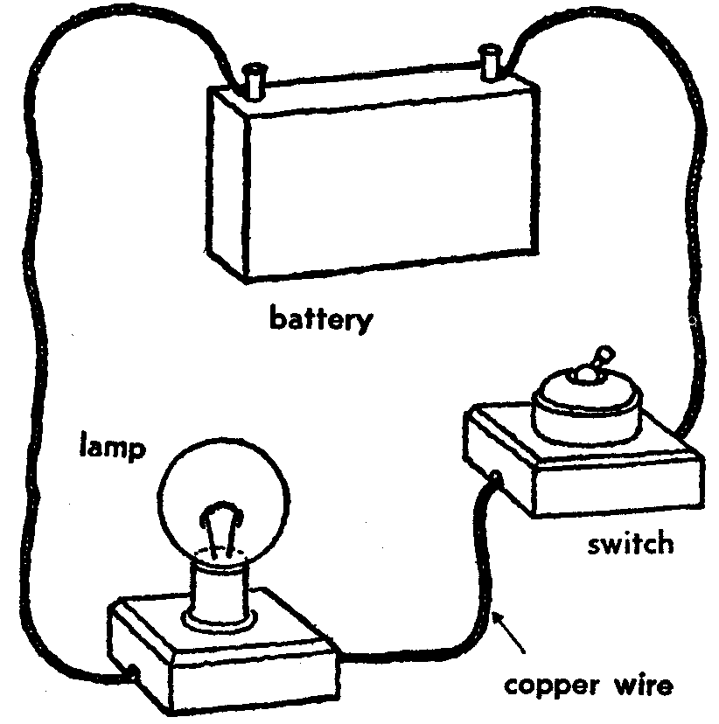
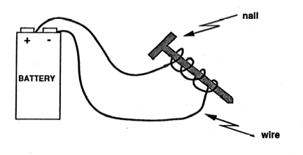
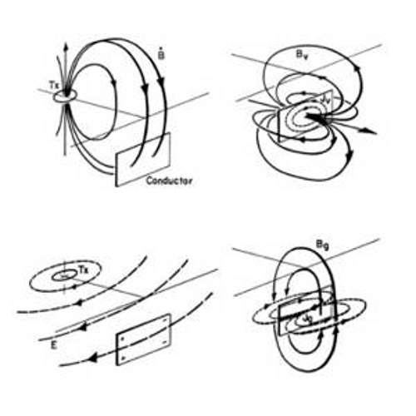
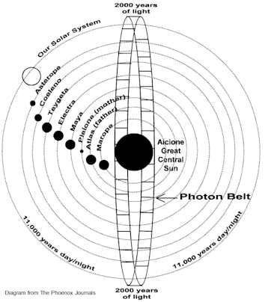
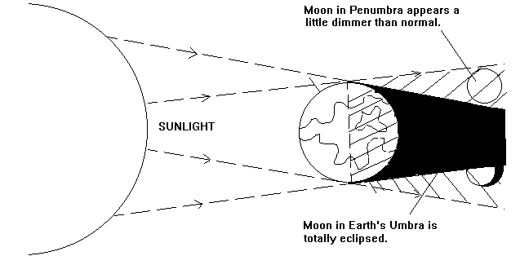
aur ab kya padhaya jaye …
“relationship between the
earth and the sun”
I selected this partly because of interest and partly out of needs coming from user’s statements
Also, installation can be good way to utilize handling capabilities & help visualization of some things which cannot never be seen at human scale, i.e. because of hugeness of solar system.
And some more reasons like…
its not thought in schools… why ? May be because its complex
It would be good for children to know this because its basics of many things
There are many misconceptions which may remain throughout life if not thought ( I faced same with me ☺)
Aur ye topic tho mujhe bhi nahi samajha tha ☹
- electricity and circuits
- magnets
- electromagnetism
- earth in solar system
- latitudes and longitude
- motions of the earth
- starts in solar system

Slide 22

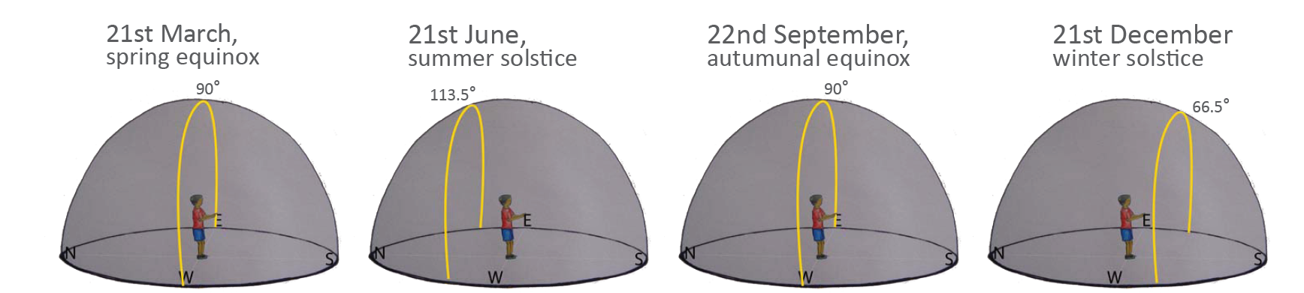
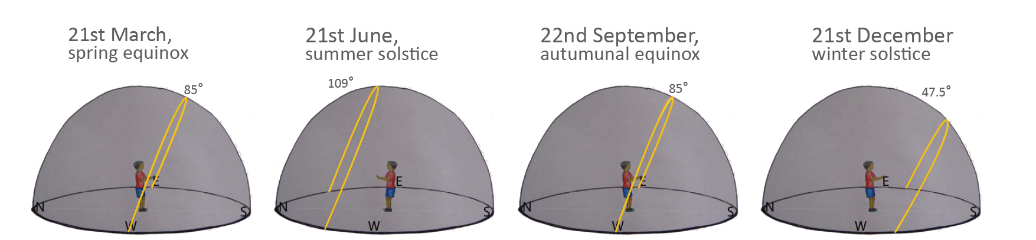
aur ab kya padhaya jaye …
exactly kya samjhana hai…
“The Content”
Singapore
Mumbai

Slide 23
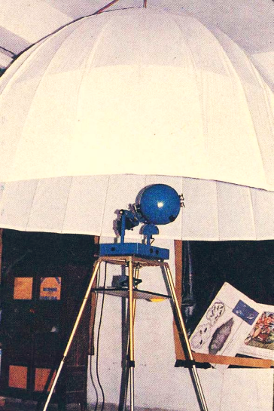
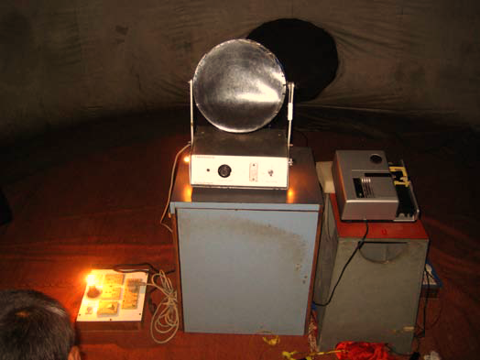


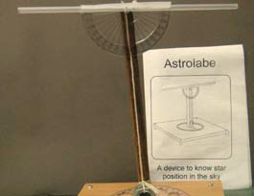
aisha kuch hai kya market me?
Some toys & installations
From game to dome like setups.
Notes:
Give some important points of evaluation focussing on screenshots and what you learned from that respective example …

Slide 24
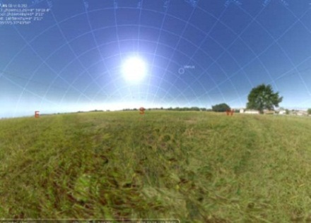
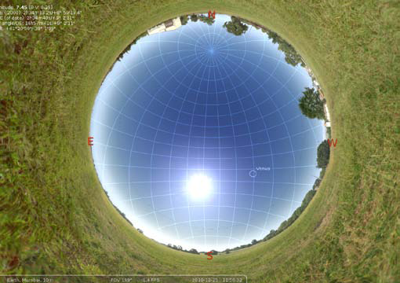
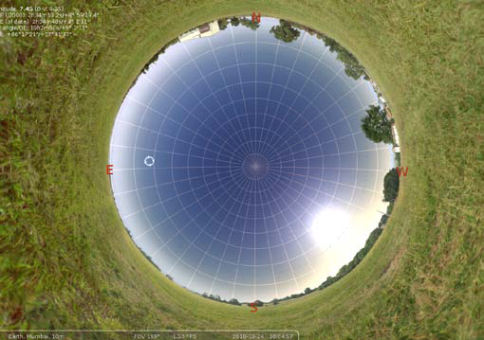
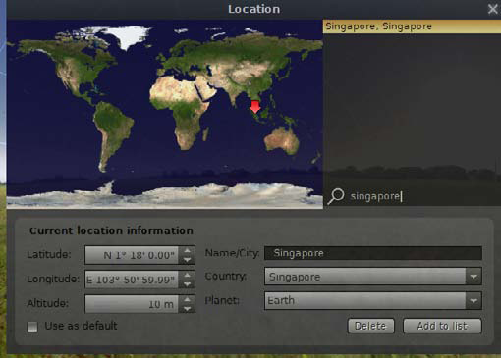
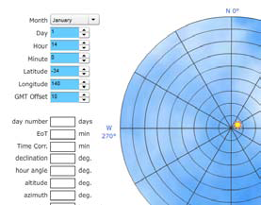
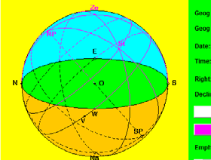
aisha kuch hai kya market me?
aur itana hi nahi kuch
kuch softwares bhi hai…
Notes:
Give some important points of evaluation focussing on screenshots and what you learned from that respective example …

Slide 25
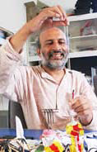
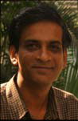
experts help on topic
Learning from Experience …
- Need to generate the idea that science is important
- It is required to tell children that
- Information in textbook is not God given
- The idea of measurement
- What looks complicated is actually simple
- Why there are several things we do not understand?

Slide 26
journey (last 5 months)
What content best suits to be taught - (detailed content to teach & how its tried today)
Played with toys and started understanding - (hands on experience and analysis)
Early morning started running - (meeting children, teachers, researchers)
Dawn of new experience in my life - (saw ray of what my project could be)

Slide 27
journey (last 5 months)
Now time to start my work - (ideation & concepts !!!)
What content best suits to be taught - (detailed content to teach & how its tried today)
Played with toys and started understanding - (hands on experience and analysis)
Early morning started running - (meeting children, teachers, researchers)
Dawn of new experience in my life - (saw ray of what my project could be)

Slide 28
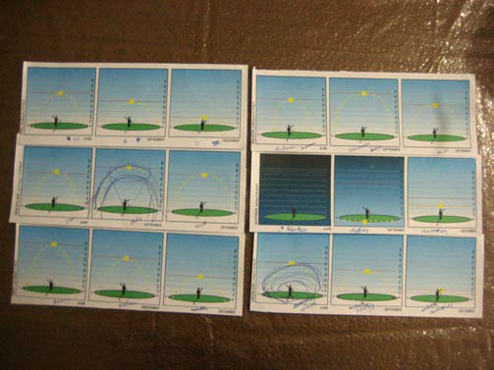
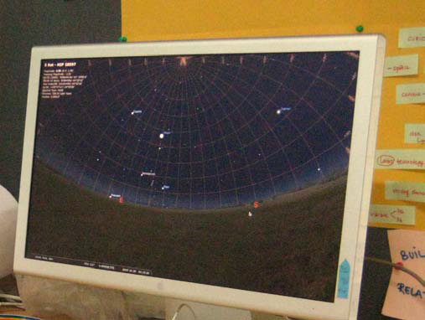
concepts [c]
2D on paper [c-1]
3D in screen [c-2]
using text book as source of inspiration and
maintaining same medium of learning design
play and learn module on a 2D surface
design an interactive application that teaches the concept of sun path and
altitude using 3d visualization
… Naaaaaa Maja nahi aayya … kuch karana padega

Slide 29
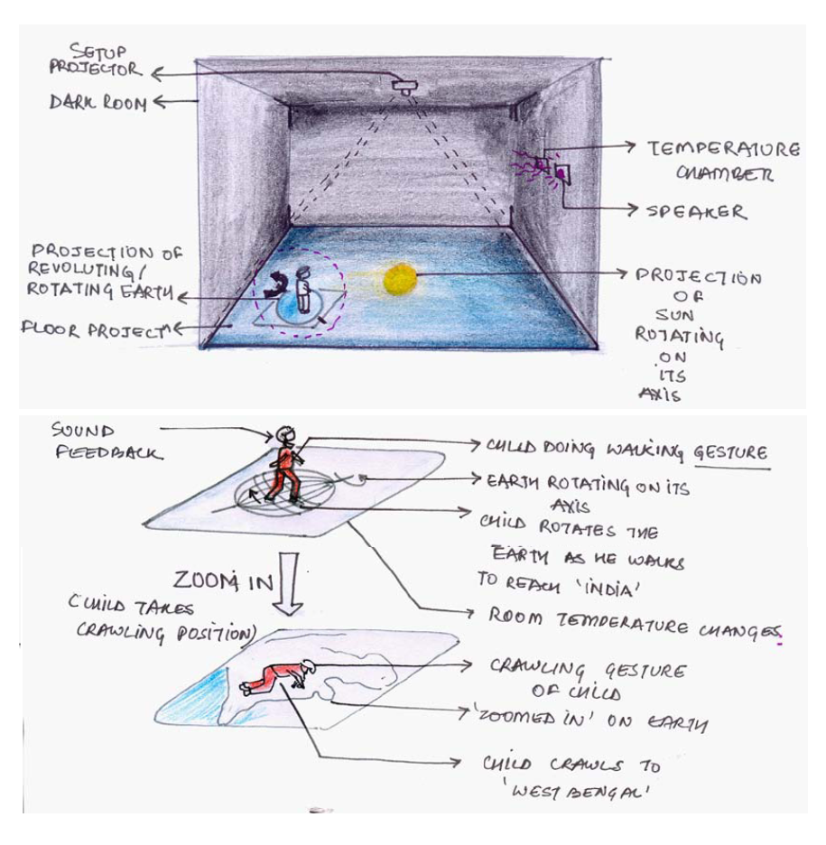
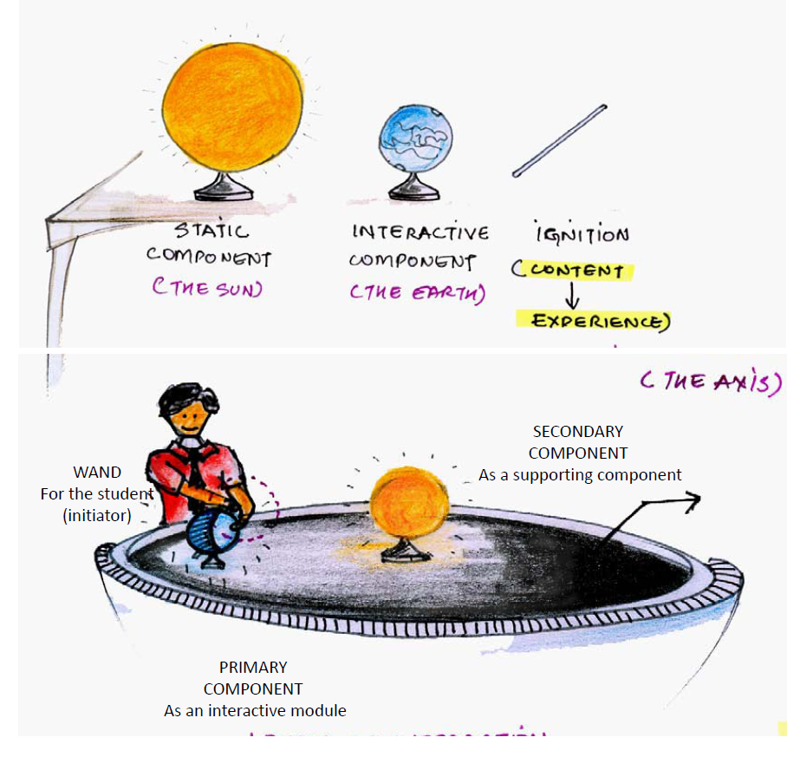
concepts [c]
Then I though of using spaces & objects to explain …
3D Chamber [c-3]
Trigger Zones [c-4]

Slide 30


concepts [c]
please also see below, I tried to keep in mind later how I will prototype it ☺
Magic Wand [c-5]
Talking Puzzle [c-6]

Slide 31



concepts [c]
Immersive Dome [c-7]

Slide 32
journey (last 5 months)
Now time to start my work - (ideation & concepts !!!)
What content best suits to be taught - (detailed content to teach & how its tried today)
Played with toys and started understanding - (hands on experience and analysis)
Early morning started running - (meeting children, teachers, researchers)
Dawn of new experience in my life - (saw ray of what my project could be)

Slide 33


journey (last 5 months)
Cloudy stage, testing time - (concept evaluation)
Now time to start my work - (ideation & concepts !!!)
What content best suits to be taught - (detailed content to teach & how its tried today)
Played with toys and started understanding - (hands on experience and analysis)
Early morning started running - (meeting children, teachers, researchers)
Dawn of new experience in my life - (saw ray of what my project could be)

Slide 34
concepts evaluation
done on the basis of
Suitability to content
Usability for children
out of 7 concepts 3 were prototyped and evaluated with users
Learning on a 2d surface (paper based Learning)
Screen Based Learning
Learning with the help of tangible objects and immersive environment

Slide 35






concepts evaluation
Screen based
Learning
2D on paper
Tasks
- Finding location on map
- Tracking sun’s trajectory
Findings
- could not understand longitude and latitude concept
- could not point change is trajectory of sun
Disadv.
- could not locate places on world correctly
- miscomm. due to linear representation of angular distance
- overall picture of “Why” is not communicated
Tasks
- Finding location on map
- Tracking sun’s trajectory
Findings
- on screen selection of place should be provided with more detail
- constraint of selecting through latitude and longitude is required
Disadv.
- on screen navigation in panoramic views creates confusion of directions
- no relationship building between what , why and how?
- could not observe small changes in sun direction with change of place
- difficult to compare as all 4 coordinates are not visible simultaneously

Slide 36




concepts evaluation
Tangible object based and Immersive Learning
Adv.
- four coordinates North, East, South, West are visible at the same time
no confusion on the direction of sun trajectory
linear and the angular movement of sun are clearly visible
ability of comparison increases to even a slight change
no confusion between north and south travelling sun
gives an overall picture of the position of earth w.r.t sun
sense of control to children as they change the location or time
Also, this fulfills needs which are enjoyed by children:
Need of Immersive Environment, Dome
Need of Physical Input model
Two Components:
Input - Physical interactive model of earth and sun
Output - Projection on a dome surface
The immersive dome concept was tested with children of age 12 to 14 years.

Slide 37
journey (last 5 months)
Cloudy stage, testing time - (concept evaluation)
Now time to start my work - (ideation & concepts !!!)
What content best suits to be taught - (detailed content to teach & how its tried today)
Played with toys and started understanding - (hands on experience and analysis)
Early morning started running - (meeting children, teachers, researchers)
Dawn of new experience in my life - (saw ray of what my project could be)

Slide 38
journey (last 5 months)
Clear Sky to Fly - (final concept detailing)
Cloudy stage, testing time - (concept evaluation)
Now time to start my work - (ideation & concepts !!!)
What content best suits to be taught - (detailed content to teach & how its tried today)
Played with toys and started understanding - (hands on experience and analysis)
Early morning started running - (meeting children, teachers, researchers)
Dawn of new experience in my life - (saw ray of what my project could be)

Slide 39


final concept

Slide 40




final concept
Hardware
- Dome
- Centre Model
Dome: for projection
Earth Centre Piece: for input

Slide 41


final concept
Types of Response
Software
Videos / Elements
To depict movement of sun
Explain longitude latitude
Visual clue of region, etc
Audio Script
To explain and assist user
To provide information
Flash Actionscript
To manage input
Select relevant videos
Warpping Software
Wrap flat videos for dome projection
System model

Slide 42

final concept
Final Scenario…
with
DEMO

Slide 43




final concept
Final Scenario…
with
DEMO

Slide 44
final concept
How is learning happening … its happening in 4 ways while at installation
1. Statements / Facts – Audio:
while they are introduced to the topic and some facts
2. Experiencing & Observations:
while the children are observing, the trajectory of sun
3. Difference and analysis:
giving reference line to compare two different trajectories and letting children to ask for
reason behind it
4. Mistake while applying:
Guessing while they asked to do it themselves, or when they manipulate and according
changes happen on path of sun (could not include in prototype due to lack of time)

Slide 45
final detailing
Some detailing done to enhance experience
Using silhouettes to give regional feel
Information graphics to improve comparison and increase learning
Audio questions / assistance to make things interesting and create curiosity
3D earth globe center piece and its inputting explorations (in report)
Longitude and Latitude rows glowing on globe while interacting with it
Location selection using direct manipulation method just via single button press
And many more …

Slide 46
Scenario Design

Slide 47



High Fidelity Prototype from outside

Slide 48




High Fidelity Prototype from inside
360 projection surface.
Interactive physical module

Slide 49



High Fidelity Prototype from inside

Slide 50
journey (last 5 months)
Clear Sky to Fly - (final concept detailing)
Cloudy stage, testing time - (concept evaluation)
Now time to start my work - (ideation & concepts !!!)
What content best suits to be taught - (detailed content to teach & how its tried today)
Played with toys and started understanding - (hands on experience and analysis)
Early morning started running - (meeting children, teachers, researchers)
Dawn of new experience in my life - (saw ray of what my project could be)

Slide 51
journey (last 5 months)
Bright day ahead- (future scope)
Clear Sky to Fly - (final concept detailing)
Cloudy stage, testing time - (concept evaluation)
Now time to start my work - (ideation & concepts !!!)
What content best suits to be taught - (detailed content to teach & how its tried today)
Played with toys and started understanding - (hands on experience and analysis)
Early morning started running - (meeting children, teachers, researchers)
Dawn of new experience in my life - (saw ray of what my project could be)

Slide 52
future scope of project
Can be used in various other domains where we can use interactive dome setups for education purpose …
School Academics
Stars, solar system, etc.
Solar panel energy
Atoms, Molecules, etc.
Electromagnetism, etc.
3D educational gaming experience
Industry Applications
Corporate Interactive 3D and rich presentation experience
To explain concepts of Solar Energy in Green Industries

Slide 53
Big Thank You;
Guide: AJ Sir
Inputs: Attu Sir, Chakku Sir, Mandar Sir, etc
Friends & Batch Mates:
IDC Workshop Staff Sirs
External guide, Internal guide
And everybody who helped me

Slide 54
Appendix

Slide 55
Journey (last 5 months)
Dawn of new experience in my life (Project Begins) (Very wedge ray of light I saw and felt let me chase it)
Every Morning Me Running for User Studies (meeting students, teachers , researchers )
Played with toy found and its analysis
What is problem and required and best to be thought ? (some options and final content)
Studies Content in Depth (short / quick explanation of content with images)
How have people tried and attempted it (toys and s/w’s to teach / explain this content) (Throwing some more light)
Initial Concepts (towards sunny now … ) Show initial concepts and its evaluations)
Its Hot Now !!! (explain them final concept in short)
And its Showtime Now … (and surprise them with demo) (Explain them some evaluation and some user responses)
Still lots more to go some improvement
Whole day still remaining … Future Scope and Examples ☺
Now its Evening … after this, its time to play and I will have some rest and fun party ☺ ☺ ☺
Acknowledgements

